Slide 1
Do I Know You? Efficient, Privacy-Preserving Protocols for Finding Common Friends
Marcin Nagy, Aalto University
(joint work with Emiliano De Cristofaro, Alexandra Dmitrienko, N. Asokan, Ahmad-Reza Sadeghi)
12th December 2013

Slide 2
Problem
How can you find if you have common friends with someone (nearby)?
… in a privacy-preserving way

Slide 3
Applications
Intuitive means for specifying access control
Ride sharing
Tethering Internet access
...
Information
Friend radar
...

Slide 4
Requirements
privacy:
no more info. to participants than about common friends
no additional info. to anybody else (e.g., FourSquare)
authenticity:
no false claims of friendship
efficiency:
applicable for mobile usage
minimize expensive crypto operations

Slide 5
Outline
Current approaches
Our approach: using Bloom Filters
“Common Friends” framework

Slide 6
Outline
Current approaches
Our approach: using Bloom Filters
“Common Friends” framework
Using bloom Filters
“Common Friends” framework

Slide 7
Using a trusted server
FourSquare, Tencent, ...
I am at <x,y>
I am at <x,y>
Bob
Angela

Slide 8
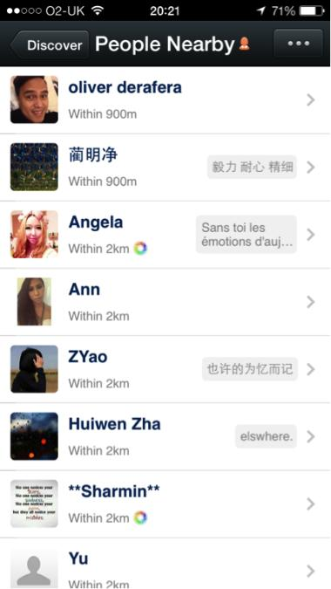
Using a trusted server
User | Location
Angela | (x,y)
Bob | (x,y)
... | ...
FourSquare, Tencent, …
Privacy | ×
Authenticity | √
Efficiency | √
Who is near me?
“Angela”
Angela
Bob

Slide 9
Private Set Intersection Protocols
Input set S_{I}
Input set S_{R}
Initiator
I
PSI
R
Responder
S_{I} ∩ S_{R}
Input set S_{I}
Input set S_{R}
Initiator
I
PSI-CA
R
Responder
|S_{I} ∩ S_{R}|
Secure in the honest-but-curious model
O(|S_{I}|+|S_{R}|) modular exponentiations
[De Cristofaro et al, FC’10, Asiacrypt ’10, CANS’12]

Slide 10
Finding Common Friends using PSI naively
Friend ID
Anna
Carol
...
Friend ID
Carol
David
...
PSI
Bob
Angela
“Carol”
Privacy | ?
Authenticity | ×
Efficiency | ×

Slide 11
Finding Common Friends using PSI with capabilities
User | Capability
Angela | xx
Bob | xx
... | ...
1. Distribute (short-lived) bearer capability to friends
Social Network
2. Private Set Intersection on capability sets to find common friends
Privacy | √
Authenticity | √
Efficiency | ×
PSI
[PeerShare, Nagy et. al., NordSec 2013 ]

Slide 12
Other approaches
Authorized PSI
Input from one side (R), authorized by a trusted (off-line) CA
O(n) modular exponentiations in the size of the input sets
Private discovery of common social contacts
Friendship certificates exchanged ahead of time
O(n) modular exponentiations in the size of the input sets
[De Cristofaro et. al., Asiacrypt’10]
[De Cristofaro et. al., ACNS’11]
Privacy | √
Authenticity | √
Efficiency | ×

Slide 13
Outline
framework
Current approaches
Our approach: using Bloom Filters
“Common Friends” framework
Using bloom Filters
“Common Friends” framework

Slide 14
Can we build a faster “PSI”?
Why are classic PSIs slow?
Designed to work even when input sets are enumerable
i.e., elements are predictable
Naive hash-each-element approach fast, but insecure for enumerable input sets
However, bearer capabilities are random
Hash-each-element approach is safe
Still O(n) communication complexity
Idea: use a Bloom Filter to represent input set

Slide 15
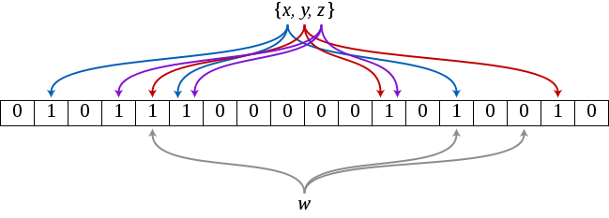
What is Bloom Filter?
Efficient data structure used for testing if an element is in the input set
Inserting
Source: Wikipedia
Testing

Slide 16
BFPSI Protocol
Initiator I
Responder R
Challenges
Secure channel
establishment
Insecure channel
Privacy | √
Authenticity | √
Efficiency | √
Man-in-the-middle
Channel binding
insert elements into BF
check each elements for presence in BF
BF
Not a replacement for
PSI in general!
False positives removal
e.g., challenge-response
False positives

Slide 17
Initiator I
Responder R
Inputs:
SK_{I},PK_{I},R_{I}
Inputs:
SK_{R},PK_{R},R_{R}
Secure channel
SK_{I}, PK_{I}
SK_{R}, PK_{R}
DH-KeyExchange
PK_{R}, K_{IR}
PK_{I}, K_{IR}
Channel binding
Bloom Filter
Challenge/response to
remove false positives

Slide 18
Beyond honest-but-curious model
Capability grants authority to anyone who possesses it
How to defend against capability loss/theft?
Use “friendship certificates”
distributed the same way as capabilities are
still O(1) exponentiations in size of the input set

Slide 19
Comparison: execution time
average of 30 runs

Slide 20
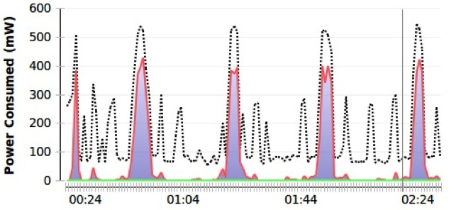
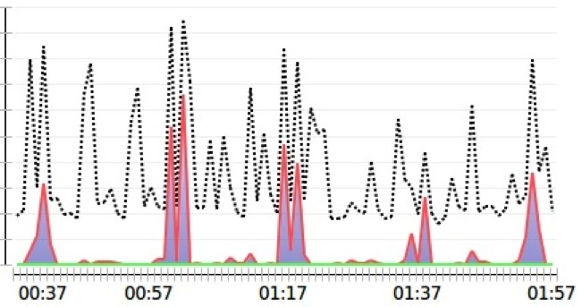
Comparison: power consumption
BFPSI (5 runs)
PSI-CA (5 runs)

Slide 21
Outline
Current approaches
Using bloom Filters
Current approaches
Using Bloom Filters
“Common Friends” framework
Using bloom Filters
skip to summary

Slide 22
Responder device
Initiator device
Common Friends Service
App
App
Common Friends Service
Inputs:
SK_{R},PK_{R},R_{R}
Inputs:
SK_{I},PK_{I},R_{I}
Set up channel
GetPublicKey
PK_{I}
IReq
accepted/rejected
StartResponder(IReq)
Initialize PSI state machine indicated by type
RRes
RRes
StartInitiator(RRes)
Initialize PSI state machine indicated by type
IRes
IRes
Process(IRes)
ResultContainer
M
ProcessContainer(M)
ResultContainer
M
ProcessContainer(M)
Optional
(possibly repeated many times)
ResultContainer
getResult
getResult
Result, K_{IR}
Result, K_{IR}

Slide 23
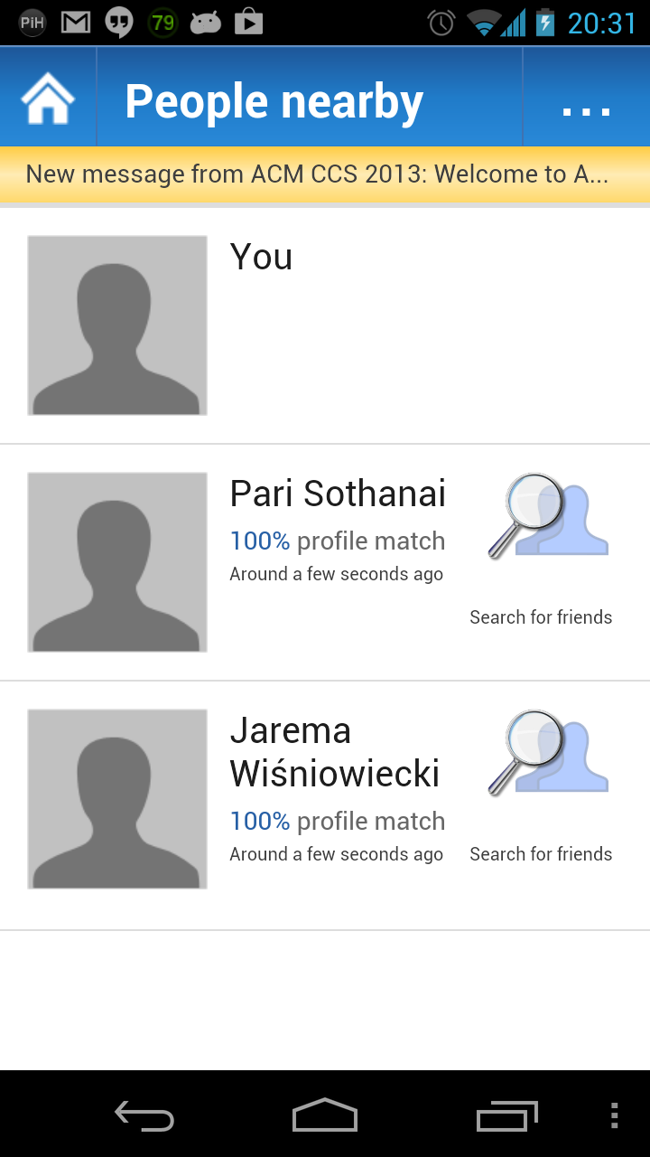
“Common Friends” Framework
Abstract interface
PSI schemes can be plugged in (currently PSI-CA and BFPSI)
Used in:
Easily re-usable by other apps
Source code available on request
TetheringApp
nearbyPeople

Slide 24
Next steps
Bloom Filter based PSI-CA?
Finding other common attributes?
...

Slide 25
Summary
A new, fast “PSI” based on bearer capabilities
Privacy and Authenticity guaranteed
False positives removed
Massive performance gain: O(1) vs. O(n)
A re-usable framework
An example of leveraging social networks to improve security/privacy/usability

Slide 26
Thank you! Questions?

