Slide 1
How far removed are you?
Scalable Privacy-Preserving Estimation of Social Path Length with Social PaL
Marcin Nagy
joint work with Thanh Bui, Emiliano De Cristofaro, N. Asokan, Jörg Ott, Ahmad-Reza Sadeghi
Notes:
DON’T INTRODUCE COLLEAGUS. DON”T INTRODUCE YOURSELF
Don’t read the title

Slide 2
Problem statement
How can you find your social graph “distance” to someone (nearby)?
… in a privacy-preserving way
John
Bob
Carol
Steve
Thomas
Notes:
Suppose there are 2 people Bob and Thomas that meet.
They want to learn what is the distance between them on the social graph.
In this case Bob should learn that he ….

Slide 3
Applications
Intuitive means for specifying access control
  Ride sharing
  Tethering Internet access
  ...
Information
  Friend radar
Routing in “dense” ad-hoc environment
Place familiarity estimation
Notes:
Use examples: Taxi from JFK to Broadway
Put emphasis on ease of use for tethering; if you’re traveling and are in the place without Internet access and don’t want to use roaming and someone else (your friend with American card) has cellular access can give you tethering access. This protocol simplifies this by automating it.
Sometimes you may also want to know who’s nearby….
Other use cases are explained in the paper

Slide 4
Nagy et al. 2013 (ACSAC 2013)
How can you find if you have common friends with someone (nearby)?
… in a privacy-preserving way
John
Bob
Carol
Steve
Thomas
Notes:
In the previous work we have developed a system to find common friends between two people nearby

Slide 5
Requirements
privacy:
  no more info. to participants than about common friends
  no additional info. to anybody else (e.g., “trusted server”)
authenticity:
  no false claims of friendship
efficiency:
  applicable for mobile usage
  minimize expensive crypto operations
Notes:
In order to have system like this, security questions come into scene.
Privacy – if I’m running the protocol with someone else, only our devices should learn about results and nobody else (no server,….).
Authenticity
Efficiency; efficiency is important especially if the application is used in mobile setting and if the protocol is to be run multiple times (frequently); second case is running it for very large input set
Minimizing modular exponentiations operations as they are expensive

Slide 6

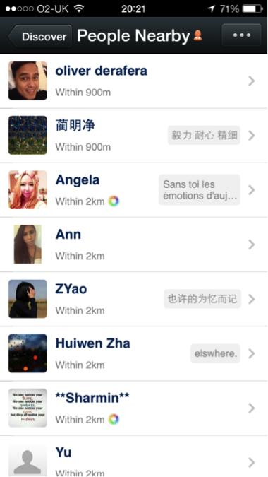


Current approach: Using a trusted server
User | Location
Alice | (x,y)
Bob | (x,y)
... | ...
FourSquare, Tencent, …
Privacy | ×
Authenticity | √
Efficiency | √
Any friends nearby?
“Alice”
Alice
Bob
Notes:
This approach is not a perfect one: server is needed, must be available on demand (at the moment of reporting),
Server provides authenticity of friendships
Server must be trusted because it finds out about locations and who is interacting with who

Slide 7
Alternative: Private Set Intersection Protocols
Input set S_{I}
Input set S_{R}
Initiator
I
PSI
R
Responder
S_{I} ∩ S_{R}
Input set S_{I}
Input set S_{R}
Initiator
I
PSI-CA
R
Responder
|S_{I} ∩ S_{R}|
Privacy | ?
Authenticity | ×
Efficiency | ×
Secure in the honest-but-curious model
O(|S_{I}|+|S_{R}|) modular exponentiations
[De Cristofaro et al, FC’10, Asiacrypt ’10, CANS’12]
Notes:
PSI is about intersection of SETS
If we apply friend lists as sets, we can use PSI for common friend finding
PSI deals only with privacy, and doesn’t concern authenticity of inputs
Say that seemingly provides privacy, but doesn’t provide authenticity in common friends finding problem.
You can use whole phonebook as input!!!

Slide 8
Our approach
Bootstrap from popular online social networks
  user authentication, social graph
But don’t cede more information to them
Notes:
Authenticity is the key to success. How to address it?
We want to make use of what’s available and don’t build something that nobody will use
Our motto was "use servers for what they already know and are good at, but don't cede any new information to them"

Slide 9



Finding Common Friends using PSI with capabilities
User | Capability
Carol
Tom
... | ...
1. Distribute (short-lived) bearer capability to friends
Social Network
App Server
2. Private Set Intersection on capability sets to find common friends
Privacy | √
Authenticity | √
Efficiency | ×
Privacy | √
Authenticity | √
Efficiency | √
PSI
Bloom Filter based PSI
“Common Friends”: Nagy et al, ACSAC 2013
Notes:
How do we apply it to PSI?
Say it’s Hash and compare approach.
Bloom filter is only compression.

Slide 10
Going from Common Friends to “graph” distances
Two challenges:
Bootstrapping is a problem
Going beyond social paths of length 2

Slide 11
Bootstrapping the system
Only participating users upload capabilities
Friend ID
John
Carol
Friend ID
John
BFPSI
Bob
Alice
The system can only find common friends who are participating in the system
Notes:
Bob meets Alice and they have a common friend John who is not system user and he’s capability is missing.
Carol uses system, so Bob inserts her capability, and results are correct but unexpected for participants since John is not discovered as a common friend

Slide 12
Fixing bootstrapping: Ersatz nodes
Assumption:
App server may query Social Network for list of friends of a participating user
Have App server create replacements for missing users
Identify friends of participating users
Create/maintain capabilities for those missing
Ersatz node = Social Network identity + server generated capability
Notes:
OSN servers provide interfaces for querying for list of friends of people that use the system
App Server uses such interface and thus it can identify subset of people that are friends of users but don’t use the system
For these people, app server creates…

Slide 13
Fixing bootstrapping: Ersatz nodes
(3) Server generates ersatz nodes for missing users
(2) Server retrieves Bob’s friends
User | Capability
Carol
Friends(Bob) = {Carol, John}
Bob
App Server
Social Network
John
(4) Bob downloads capabilities
Bob uploads capability
(Carol, )
(John, )
(Bob, )
Bob

Slide 14
Fixing bootstrapping: Ersatz nodes
User | Capability
Carol
John
Bob
Alice
App Server
Friend ID
Carol
John
Friend ID
John
BF-PSI
Bob
Alice
With ersatz nodes all common friends are always discovered

Slide 15
Beyond paths of length 2:
Social Path Length
minimum number of hops in social graph between two users
Social PaL
application calculating social path length between two users
Notes:
The second challenge
I want to define two terms that I will keep using

Slide 16
Additional requirements
Privacy:
  Two users can’t learn more than by gathering information using standard social network interfaces available to them
Functional:
  Maximize number of paths discovered between two users
  Determine exact path length between two users
Notes:
Since we go beyond 2 hops, we must specify additional requirements

Slide 17
Capabilities as path length proofs
Intuition:
Capability distributed to friends used as friendship proof
Use hash chains to generate higher order capabilities
From capability c generate i^{th} order capability:
Distribute c^{i} to contacts i+1 hops away
Recipient includes c^{i}, c^{i+1}, …, c^{n} in input to PSI
i+1
Notes:
Possession of higher order capability is a proof of path existence
Order of higher order capability indicates length of path

Slide 18
Social PaL graph building
Social PaL only learns friend lists of actual users
  users explicitly authorize Social PaL
Notes:
To provide a correct capability distribution server must build a graph.
Server learns during building this graph by querying OSN for friends list and aggregating them.
This is about what server learns. If two users have common friend, the server will learn about it.

Slide 19
Social PaL capability distribution
John
Bob
Carol
Steve
Thomas
Alice
App Server
1
Carol
John:
Anon:
1
1
1
2
Friends’ capabilities returned with identities
Higher order capabilities returned w/o identities
Bob

Slide 20
Social PaL path length discovery
1
2
2
Friend ID
Thomas
Anon
Friend ID
Carol
Anon
John
1
2
2
1
2
1
2
1
2
Bloom Filter based PSI
2
2
Bob
Alice
1
2
2
2
= 4
D(Bob, Alice)=4
2
+
2
= 4
2
+
2
1
2
2
1
Friend ID
Carol
Anon
John
1
2
2
Friend ID
Alice
Steve
Anon
2
2
1
1
2
1
2
Bloom Filter based PSI
2
1
2
1
2
Bob
Thomas
2
2
+
2
= 4
2
2
2
2
1
+
2
= 3
D(Bob, Thomas)=3
1
+
2
= 3
2
+
2
= 4
John
Bob
Carol
Steve
Thomas
Alice
Notes:
What’s the name of the color? Brown?

Slide 21
Dataset for estimating coverage
Social Filter dataset
  By Sirivanos et al
  Derived from dataset by Gjoka et al (UC Irvine)
  500 000 users; 30 connections on average
  sampling did not preserve node degree
  Metropolis Hastings Random Walk (MHRW) dataset
  95 700 “sampled users”, 175 connections on average
  72.2 million “outside users”
  among sampled users: 3 connections on average
Breadth First Search (BFS) dataset
  Sampled using breadth-first search
  2.2 million sampled users, 310 connections on average
  93.8 million “outside users”
  among sampled users: 53 connections on average
Notes:
In the paper we measure coverage of SocialPaL which is probability that two users discover an existing path between them in the social network
We measured it for 3 datasets obtained from Minos Gjoka
I’d like to show results only from 1 set, others are described in the paper.

Slide 22
Coverage: Social Filter dataset

Slide 23
Coverage: MHRW dataset (random walk)
X-axis shows fraction of sampled users
Sampled users: 957 000
Outside users: 72.2 million

Slide 24
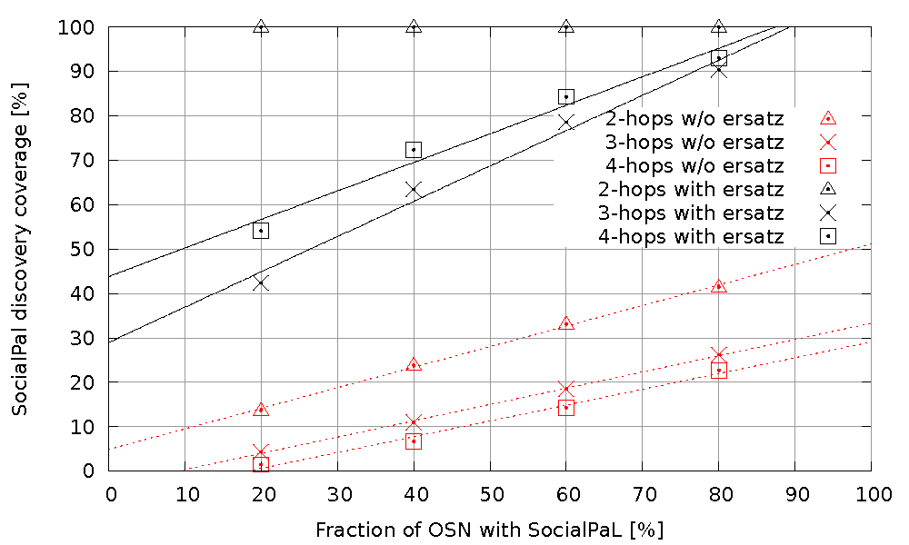
Coverage: Breadth-first search dataset
X-axis shows fraction of sampled users
Sampled users: 2,2 million
Total users: 93,8 million
Notes:
We measure coverage
Explain triangles, crosses and rectangles.
For paths of length 2, always all paths discovered
Ersatz nodes improve discoverability
For longer paths, percentage of discovered paths increases with number of Social PaL users

Slide 25
Coverage analysis summary
Use of ersatz nodes significantly increases coverage
  Always 100 % coverage for 2-hop paths (detects all)
  Only 20% users with Social PaL: coverage > 40%
  80% users with Social PaL: coverage > 80%, always
Coverage is better in datasets with higher connectivity
  BFS dataset ~ Social Network in regions with high penetration
4-hop paths more readily discovered than 3-hop paths!

Slide 26






System architecture
OSN servers
Internet
SoPaL server
Mobile users
Notes:
Don’t say we don’t need connectivity. Periodic connectivity is needed for refreshing capabilities.

Slide 27
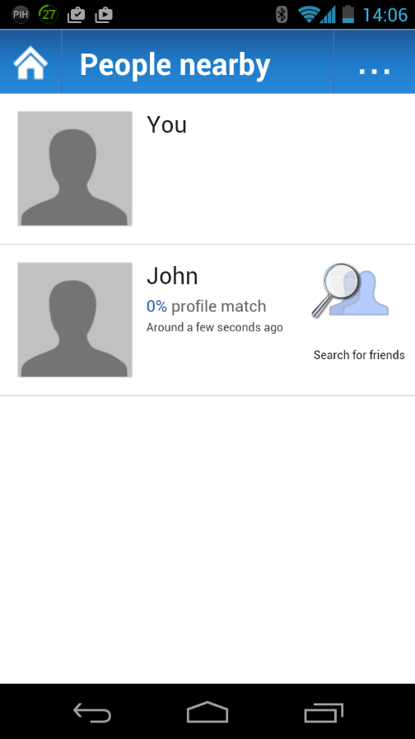
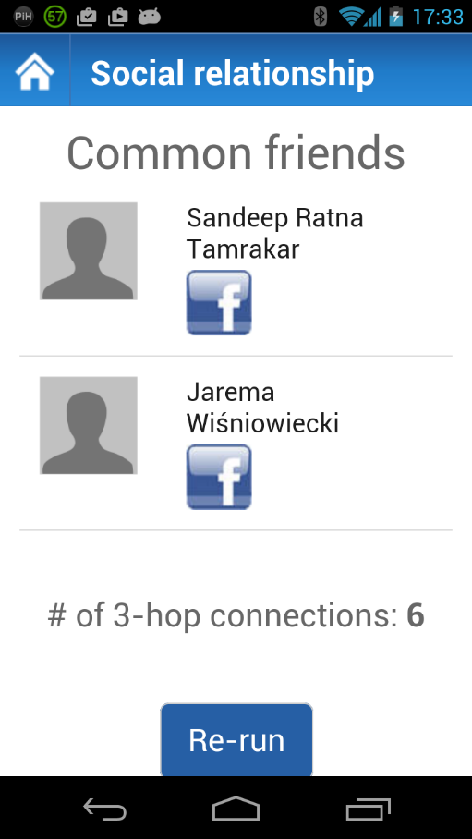

Example App: nearbyPeople
Marcin
Nagy
nearbyPeople

Slide 28
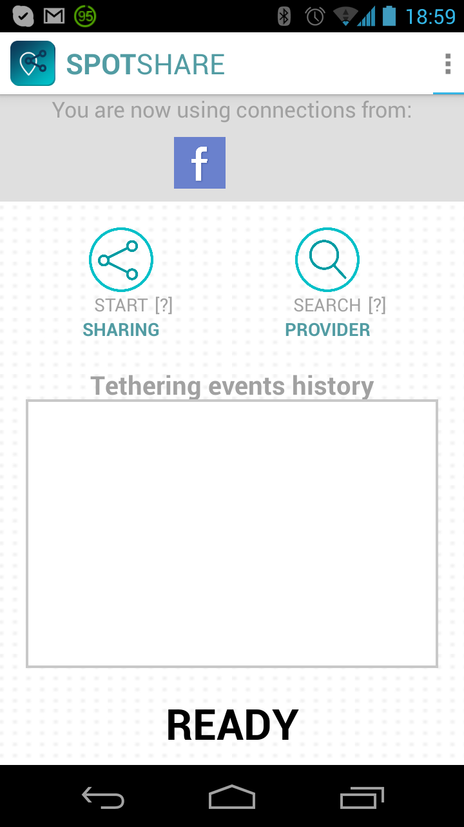
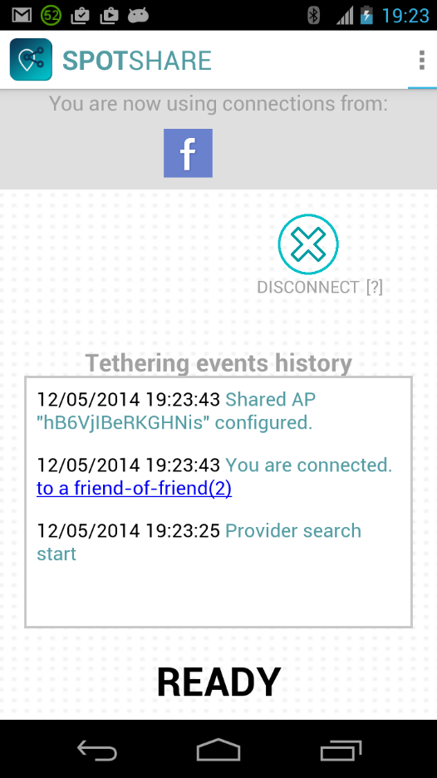
Example App: SpotShare
SpotShare
(Google Play)

Slide 29
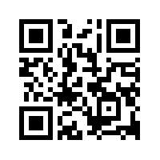
Summary
Privacy-preserving, scalable protocols for finding
  common friends
  lengths of social paths
Used in two applications (available for download)
  Easy-to-use tethering (“SpotShare”)
  Friend radar (“nearbyPeople”)
Source code available for research use
More info at https://se-sy.org/projects/pet/

Slide 30
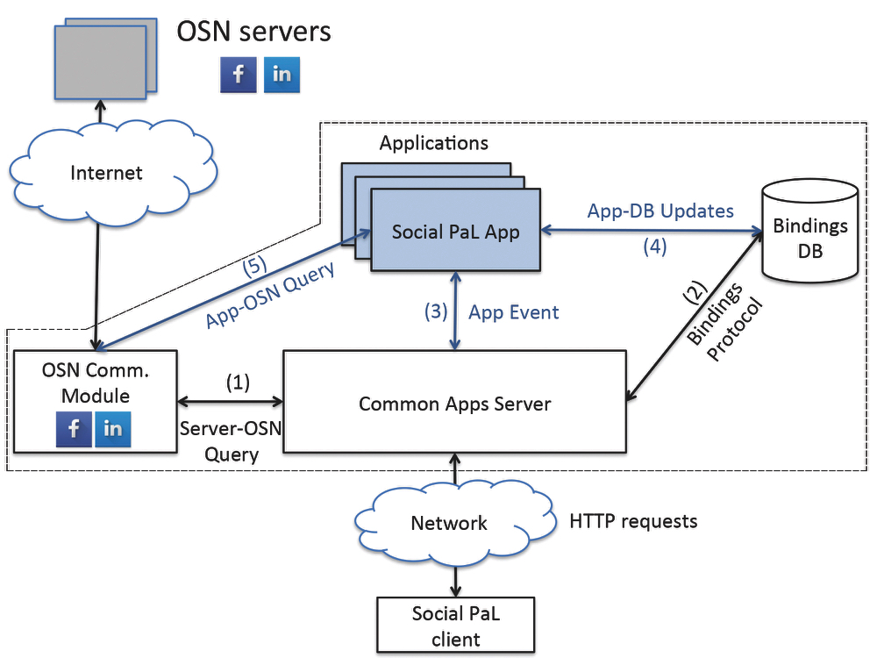
Social PaL server architecture

Slide 31
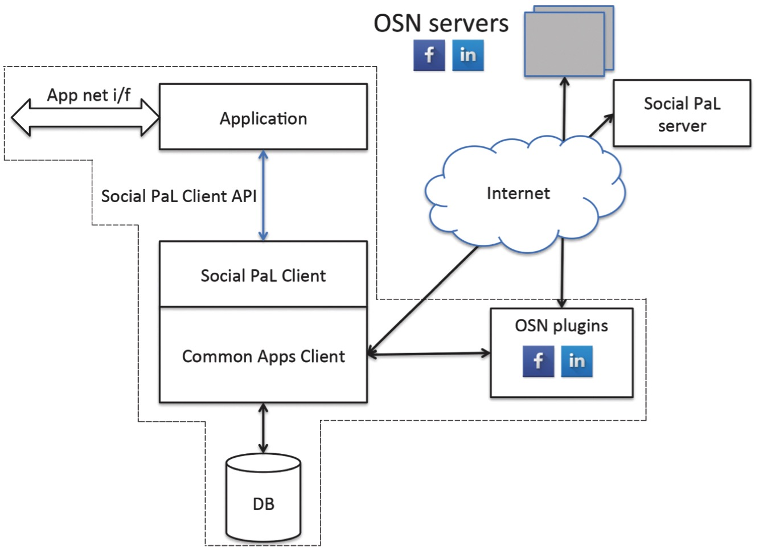
Social PaL client architecture

Slide 32
Simulation for estimating coverage
Test set: randomly choose x% of “sampled users”
  x = 20, 40, 60, 80 (represents fraction using Social Pal)
Pick 50k pairs randomly from “test set” w/ k-hop path
  k = 2, 3, 4
Compute fraction for which Social PaL discovers path
Repeat steps 1-3 ten times; average results

Slide 33
Simulation for estimating coverage
Test set: randomly choose x% of users
  x = 20, 40, 60, 80 (represents fraction using Social Pal)
Pick 50k pairs randomly from “test set” w/ k-hop path
  k = 2, 3, 4
Compute fraction for which Social PaL discovers path
Repeat steps 1-3 ten times; average results

