Slide 1
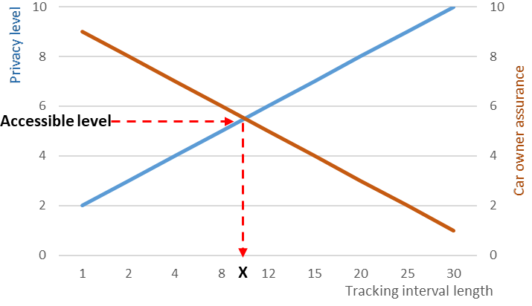
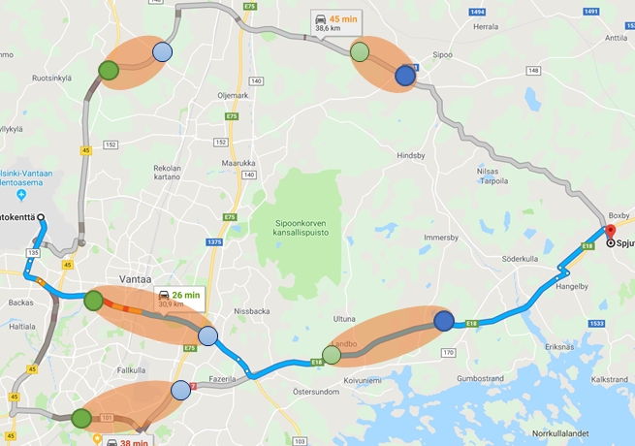
Andrey Shorov and Valtteri Niemi
Privacy issues of autonomous shared vehicles
Motivation
Autonomous vehicles are an important car sharing service scenario
Car sharing operators track users continuously during user trip → privacy concerns
One option is to refuse continuous tracking and to use selective tracking interval
It is important to find a trade-off between user privacy and car owner assurance
Privacy calculations
We focus on location privacy i.e. how to preserve uncertainty about user path while maintaining assurance for car owner
How to find privacy level that satisfies both user and car owner?
Shannon Entropy
measures adversary
uncertainty:
Design
Three phases of service timeline
$$H(X)= −\sum_{x∈X}{\left.p(x\right)} \log_{2}\left.p(x\right)$$
Main focus on location privacy during the trip
Maximum movement boundary attack*
Car owner can find visited POI even if no permanent tracking
Implementation
Google maps:
Both user and vehicle owner can find potential path
User can choose most private path
Car owner can evaluate where is user at certain moment
Library can be embedded to maps applications
Attacker can find potential position of a user based on moving speed
Design consideration using attack principle
Probability of no stops based on lognormal distribution
Probability of visit POI using mean time to visit and POI rating with help of normal distribution
Total entropy for path created by Google maps
Another way of use:
Path can be recovered if user was spotted between two points
If surveillance spots are known, user can increase his/her privacy during journey
†
*Ghinita G, et al. (2009) Preventing velocity-based linkage attacks in location-aware applications. Proc. of the 17th ACM SIGSPATIAL int.
conf. on advances in geographic information systems, pp 246–255
† Mastroianni, P., et al. (2015) Local optimization strategies in urban vehicular mobility. PloS one, 10(12)

